Slide 1
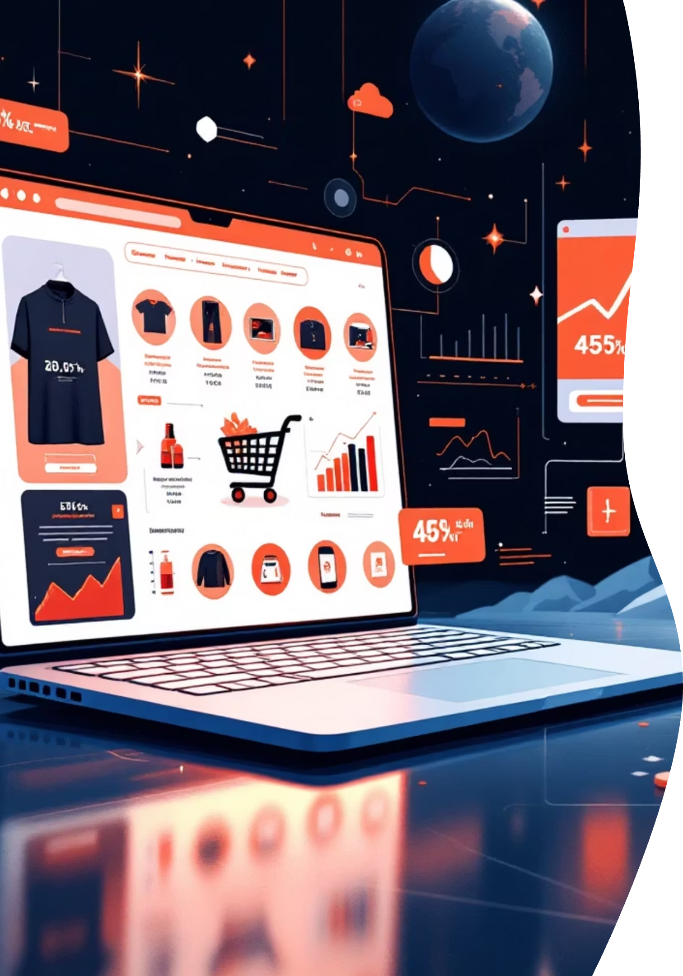
End-to-End Data Science Project on E-commerce Data
Web Scraping, Data Analysis & Machine Learning
Priyanka K| DADS Aug-A 2025

Slide 2


PROJECT OVERVIEW
Analyzing E-commerce Market Dynamics Through Data
This comprehensive project leverages advanced data science techniques to analyze product data from e-commerce platforms, uncovering critical market trends and customer preferences that drive business decisions.
Through systematic data collection, rigorous analysis, and machine learning modeling, we transform raw e-commerce data into actionable intelligence that supports strategic planning and competitive positioning.
01
02
03
Data Collection
Data Preparation
Exploratory Analysis
Automated web scraping captures real-time product information
Cleaning and preprocessing ensures data quality and consistency
Statistical analysis reveals patterns and market insights
04
05
ML Modeling
Business Insights
Advanced algorithms predict trends and categorize products
Data-driven recommendations support strategic decisions

Slide 3







OBJECTIVES
Project Goals & Strategic Outcomes
This project encompasses a complete data science workflow designed to extract maximum value from e-commerce data, delivering insights that enhance business intelligence and operational efficiency.
Automated Data Collection
Data Quality Management
Efficient Data Storage
Scrape product data from e-commerce websites using robust web scraping techniques that capture key attributes including price, category, ratings, and customer reviews
Clean and preprocess raw data to eliminate inconsistencies, handle missing values, and standardize formats for reliable analysis
Store refined data in structured databases enabling fast queries, scalability, and seamless integration with analytical tools
Machine Learning Implementation
Business Intelligence
Actionable Recommendations
Apply supervised and unsupervised learning techniques to build predictive models and discover hidden patterns in product data
Extract meaningful insights that inform pricing strategies, inventory management, and customer segmentation initiatives
Deliver data-driven insights that support strategic decision-making and competitive advantage in the marketplace

Slide 4

PHASE 1
Web Scraping: Capturing Real-Time Data
Web scraping forms the foundation of our data pipeline, automatically extracting product information from e-commerce platforms to build comprehensive datasets for analysis.
Data Extracted
Product names and descriptions
Current pricing and discount information
Product categories and subcategories
Customer ratings and review counts
Availability and stock status
Technology Stack
BeautifulSoup and Scrapy for HTML parsing and data extraction
Requests library for HTTP communication
Export to CSV format for downstream processing

Slide 5


PHASE 2
Data Cleaning & Preprocessing
Raw data requires systematic cleaning and transformation to ensure accuracy and reliability. Our preprocessing pipeline addresses data quality issues and prepares the dataset for advanced analytics.
Key Preprocessing Steps
1
Missing Value Treatment
Imputation strategies and removal of incomplete records
2
Duplicate Removal
Identifying and eliminating redundant entries
3
Format Standardization
Normalizing currency, dates, and text fields
4
Feature Engineering
Creating derived variables for enhanced analysis
5
Outlier Detection
Identifying and handling anomalous data points
Quality Assurance: This comprehensive preprocessing ensures data consistency, eliminates noise, and maximizes the accuracy of downstream machine learning models.

Slide 6

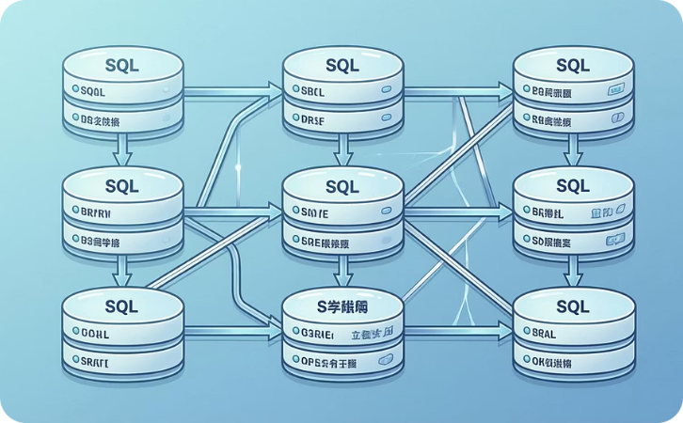

Data Storage & Management
The cleaned dataset is stored in a robust relational database infrastructure that enables efficient querying, scalability, and seamless integration with analytical tools and machine learning pipelines.
SQLAlchemy ORM
SQLite & MySQL
Scalable Architecture
Python-based object-relational mapping for seamless database interactions and query generation
Flexible database options supporting both lightweight local storage and enterprise-scale deployments
Cloud-ready infrastructure that grows with data volume and analytical demands
Key Benefits of Structured Storage
Organized Data Architecture
Growth-Ready Infrastructure
Well-defined schemas and relationships maintain data integrity
Easily scales to accommodate increasing data volumes
High-Performance Queries
Analytics Integration
Indexed tables enable rapid data retrieval and complex joins
Native compatibility with BI tools and ML frameworks

Slide 7


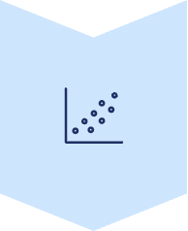



UNSUPERVISED LEARNING
Product Clustering & Segmentation
Unsupervised learning techniques reveal natural groupings within product data, identifying segments with similar characteristics that inform marketing strategies and inventory optimization.
K-Means Clustering Methodology
Feature Selection
Identify relevant attributes for clustering analysis
Optimal Cluster Determination
Use elbow method and silhouette scores to find ideal K
Algorithm Application
Execute K-Means to group similar products
Label Assignment
Assign cluster identities and interpret patterns
Business Value: Clustering reveals hidden product categories, enables targeted marketing campaigns, and optimizes inventory management through data-driven segmentation.

Slide 8
SUPERVISED LEARNING
Classification Models: Predicting Product Categories
Supervised learning algorithms predict product categories and labels with high accuracy, enabling automated classification of new products and supporting intelligent recommendation systems.
Machine Learning Model Portfolio
Logistic Regression
Support Vector Machine
K-Nearest Neighbors
Baseline probabilistic classifier for binary and multi-class problems
High-dimensional classification with kernel methods for complex boundaries
Instance-based learning using proximity metrics for classification
Random Forest
XGBoost
Ensemble of decision trees providing robust predictions and feature importance
Gradient boosting framework delivering state-of-the-art performance
Model Evaluation Metrics
Accuracy: Overall correctness of predictions across all classes
Recall: Ability to identify all relevant instances
Precision: Accuracy of positive predictions to minimize false positives
F1-Score: Harmonic mean balancing precision and recall

Slide 9



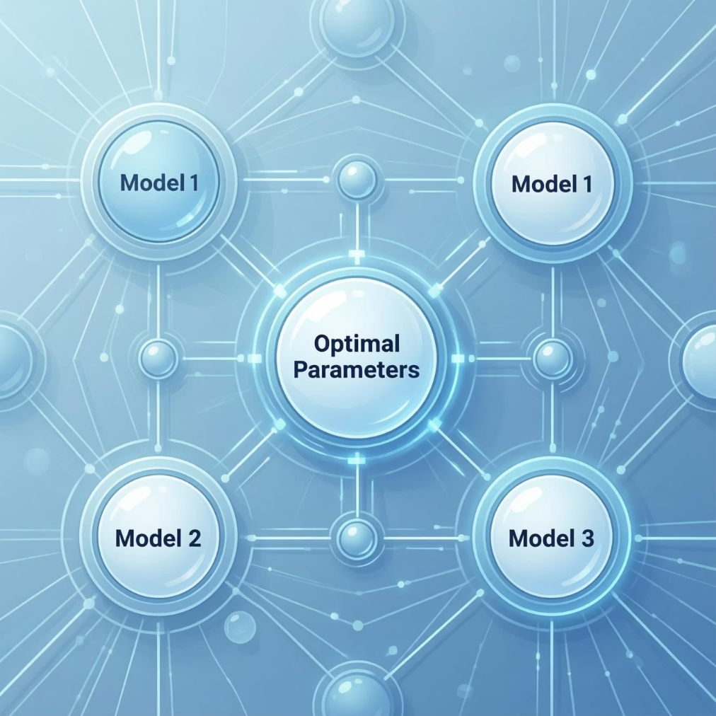
Hyperparameter Tuning & Optimization
Systematic hyperparameter tuning maximizes model performance by exploring parameter spaces to find optimal configurations that balance accuracy, generalization, and computational efficiency.
Optimization Techniques
Grid Search
Exhaustive search across predefined parameter combinations to identify the best-performing configuration systematically
Random Search
Efficient sampling of parameter space using random combinations, often finding optimal solutions faster than grid search
Optimization Benefits
Fine-tune learning rates, regularization, and model complexity
Reduce overfitting through cross-validation strategies
Improve accuracy and generalization on unseen data
Balance model performance with computational costs
"The best-performing model emerges from rigorous experimentation and optimization, delivering superior predictive accuracy for production deployment."

Slide 10

PROJECT COMPLETION
Conclusion & Deliverables
Project Conclusion
Project Deliverables
This project demonstrates a complete data science lifecycle, from initial data collection through model deployment, showcasing technical proficiency across web scraping, data engineering, machine learning, and business analytics.
Cleaned Dataset
The comprehensive workflow transforms raw e-commerce data into actionable intelligence, delivering measurable business value through predictive models and strategic insights that drive competitive advantage.
Production-ready data with documentation
ML Models
Trained algorithms with performance metrics
Visualizations
Interactive dashboards and analytical charts
Insights Report
Business recommendations with data support
Presentation
Executive summary and technical deep-dive
Source Code
Well-documented, modular, reusable codebase
Thank you for your consideration. I look forward to discussing how these data science capabilities can drive value in your organization.

